Slide 1
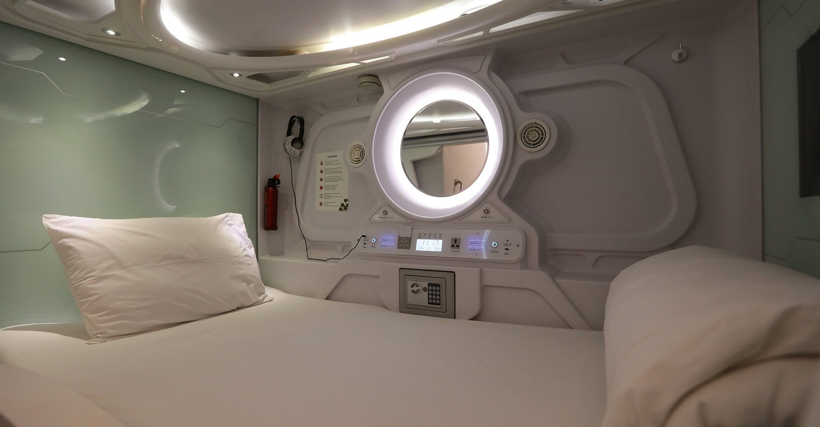
BONPOD
By: Pranav Kumar- 16UG08032
Pranjal Gupta – 16UG08034
Sapna Kumari – 16UG08046
Saranya T– 16UG08047
Under the Guidance of:
Dr. Rubini P
Associate Professor
Dept. of CSE,SOET

Slide 2
Contents:
Introduction
Objectives
Literature survey
Software and hardware requirement
Disadvantages of Existing System
Methodology and Proposed System
System Implementation and codes
Result and Analysis
Conclusion

Slide 3

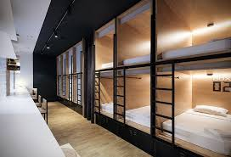
A “BONPOD” hotel is also known in the western world POD hotel is a typed of hotel developed in Japan that features many small bed-sized rooms known as capsules. Bonpod hotels provide cheap, basic overnight accommodation for guests who do not require or who cannot afford larger, more expensive rooms offered by more conventional hotels.
The bonpod are stacked side-by-side, two units high, with steps or ladders providing access to the second level rooms, similar to Bunks bed. The open end of the bonpod can be closed with a curtain or a solid door for privacy, but cannot be locked. Like a hostel many amenities are communally shared, including toilets, showers, wireless internet, and dining rooms.

Slide 4

“Bonpod, A POD hotel” is developed with the main aim of providing cheap, basic overnight accommodation for guests who do not require or who cannot afford larger, more expensive rooms offered by more conventional hotels.
The BONPOD are stacked side-by-side, two units high, with steps or ladders providing access to the second level rooms, similar to Bunks bed. The open end of the bonpod can be closed with a curtain or a solid door for privacy, but cannot be locked.
Like a hostel many amenities are communally shared, including toilets, showers, wireless internet, and dining rooms. Bonpod hotels vary in size, from 50 or so capsules to 700, and primarily cater to men Some bonpod hotels offer separate sections for male and female guests, or even separate floors and separate elevators.

Slide 5

Literature Survey
In[1]: Sue et al (2005) ‘the Hotel Proprietors Act 1956 provides a clear definition of a hotel: An establish held out by the proprietor as offering food, drink and, if so required, sleeping accommodation, without special contract, to any traveller presenting himself who appears able and willing to pay reasonable sum for the services and facilities provided and who is in a fit state to be received.’
In[2]: Japanblog(2007) “A capsule hotel is a type of hotel accommodation popular mostly among travellers stranded for the night and those who are on a tight budget.” Capsules hotel are usually about 2m * 1m*1.5m in dimension and so is unsuitable for those above six feet tall. Despite the very limited space the customers will be surprised at how well equipped these hotels are. Each capsule usually comes with a built in mini TV, radio, and alarm clock, plus fresh bedding of course. Customers can also use the hotel’s public lounge space including lockers, shower rooms, laundry facilities, restaurants, vending machines, and clothes shop.

Slide 6

In[3]: Chon (2000)has suggested all psychological motives could be classified as basic motives and secondary motives. In the hospitality industry, people’s basic needs from a lodging facility are a good night’s rest in a comfortable and soft room and food. Secondary motives are fulfilled by celebrating special moments, such as theme night, birthdays and so on
In[4]: Middleton and Clarke (2001:19)suggest, in term of customer, marketing is concerned with understanding the needs and desired of existing and future buyers. It is also about which products they choose, when, how much, at what price and how often they purchase them. It is concerned with how they get information about the products, where they buy the products from-whether they are bought directly of through retail intermediary- and how the customers feel after their purchase and consumption of product.
In[5]: Itravel,com(2007)defined since most visitors to a Capsule hotel are Japanese business men who don’t have time to go home, there are amenities there for people who didn’t plan on staying away from home.

Slide 7

Software and Hardware Requirement
SOFTWARE REQUIREMENTS:
Operating system:
• Windows 7, Windows 8 or Windows 10
• Mac OSX 10.8, 10.9, 10.10 or 10.11
• Linux- Debian, Fedora, Ubuntu etc
IDE used:
• Pycharm-Community-Edition 2017.3
Frameworks:
• Django Framework for backend
• Bootstrap J-query for front-end
Text Editor:
• Gedit
• Sublime Text

Slide 8
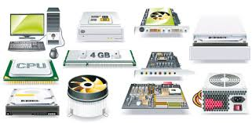
Hardware Requirement
Processor (CPU) with 2 gigahertz (GHz) frequency or above
A minimum of 2 GB of RAM
Monitor Resolution 1024 X 768 or higher
Internet Connection Broadband (high-speed) Internet connection with a speed of 4 Mbps or higher

Slide 9

Disadvantage of existing system:
Cost Effective : With prices that are often high of conventional hotels, savings are certainly not guaranteed! The average price of capsule hotels range between the accomodation budget of students per night.
Not Convenient Location: Most capsule hotels are not just a stone’s throw away from train stations, and such prime locations which bring major problems to travellers as they will be not familiar with the area. But capsule hotels are not that far away from those locations which bring major convenience.
Particular Hour Check-in: Plus, most hotels also do not have a 24-hour front desk service to assist you even if you check in during the wee hours. This is especially important if you’re saving money by flying budget airline with odd timings

Slide 10


PROPOSED SYSTEM:
To overcome the drawbacks of the existing system, the proposed system has been evolved. Capsule hotels have since become a viable option for solo travelers or groups looking to budget their accommodation in India, including its capital city of Mumbai. POD hotels bring latest technology enabled cubical capsules that facilitate different facilities which is an amazing experience for travelers.
Advantage:
Convenient Location
24-Hour Check-in
Hygienic Beds & Bathrooms

Slide 11

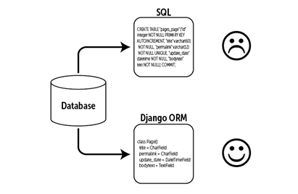
System Implementation: * The model is functionally the same. Django’s Object-Relational Mapping (ORM—more on the ORM later) provides the interface to the application database; * The template provides display logic and is the interface between the user and your Django application; and * The view manages the bulk of the applications data processing, application logic and messaging.
Django ORM

Slide 12

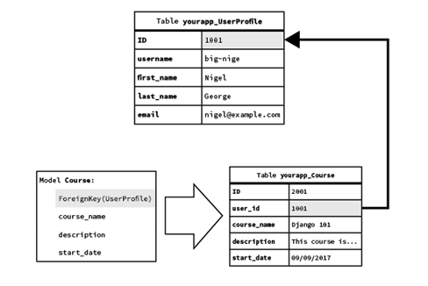
Foreign key links in Django models

Slide 13
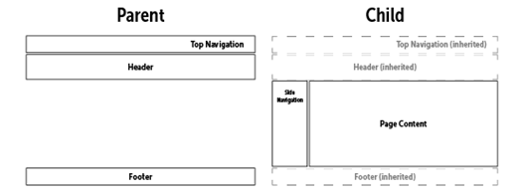
All common elements are inherited from the parent template(base)

Slide 14
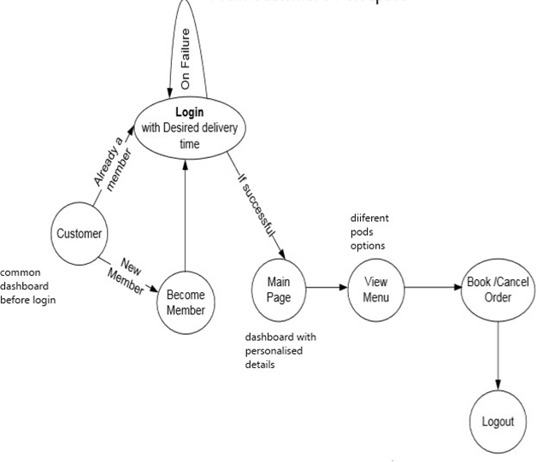
Flow Diagram

Slide 15
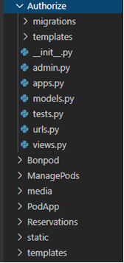
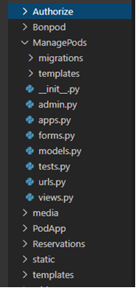
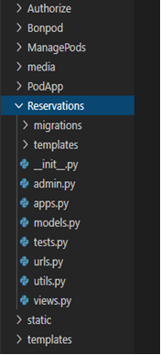
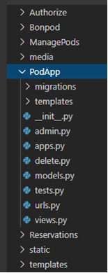
Modules in Bonpod

Slide 16

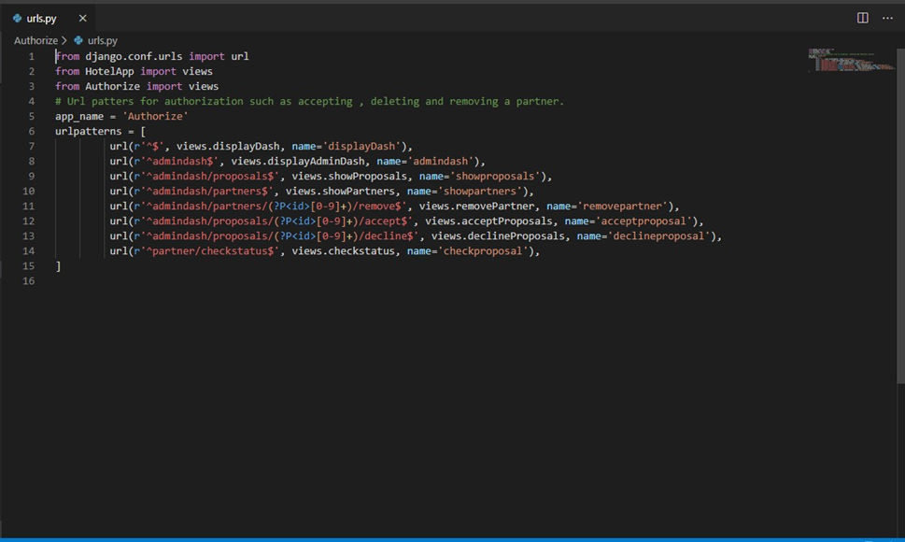
Authorized module codes

Slide 17
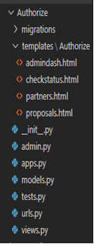
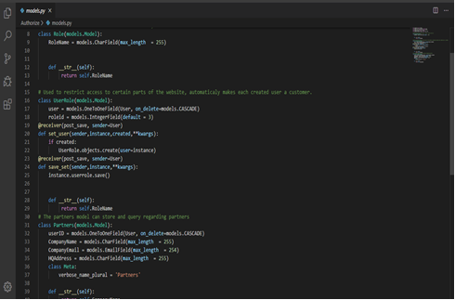
Authorize module files code

Slide 18
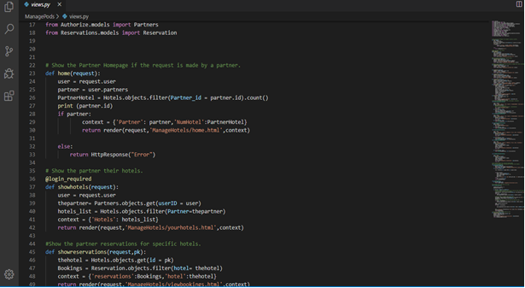
Pod Module Code

Slide 19
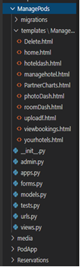
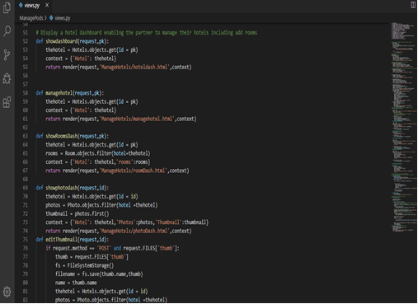
Pod module files and code

Slide 20

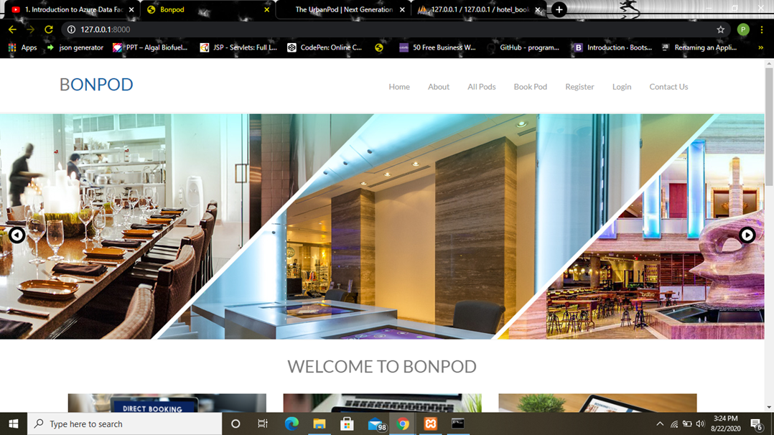
Result and Analysis
Home Page of BONPOD

Slide 21

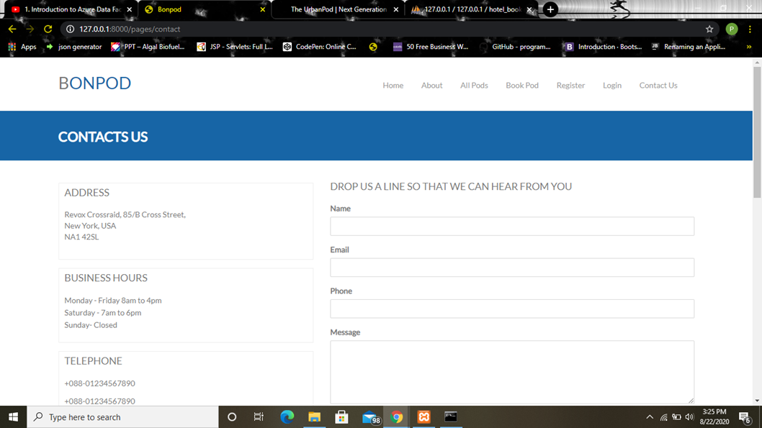
Contact us Page

Slide 22

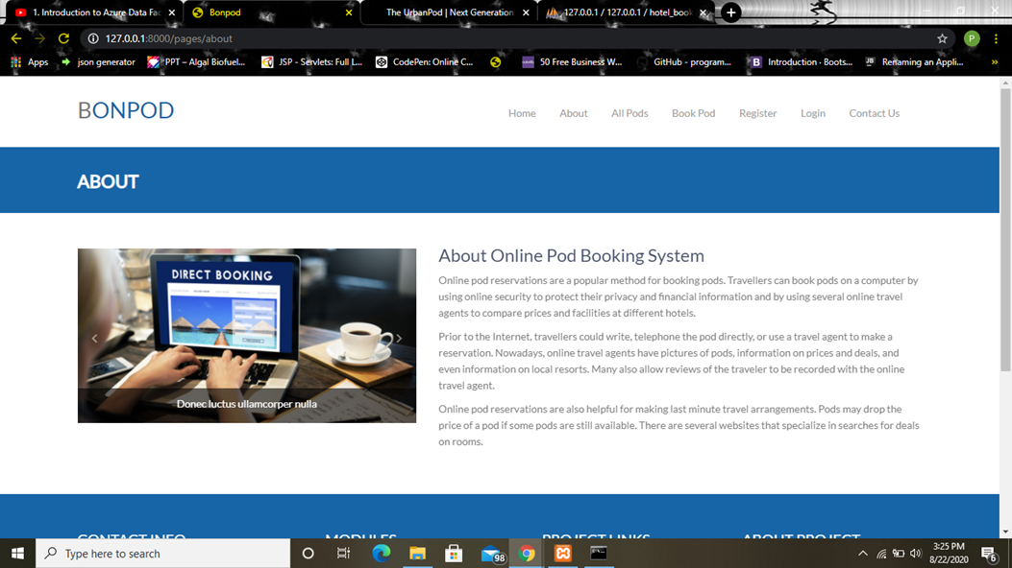
About Us Page

Slide 23


Sign-Up Page

Slide 24

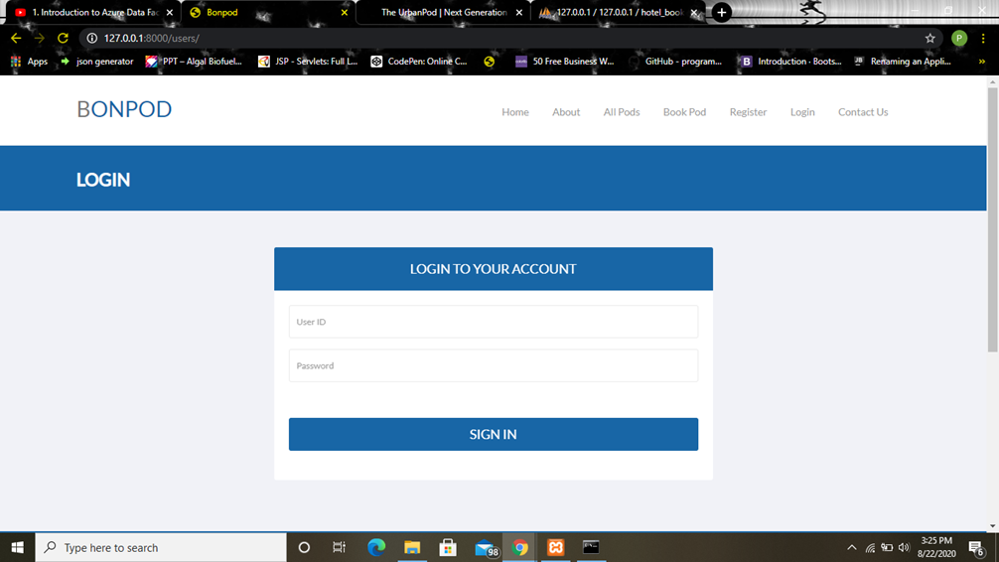
Sign-in Page

Slide 25
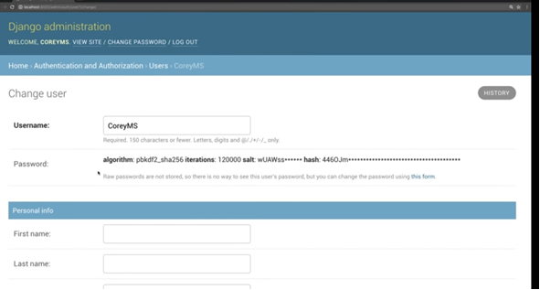
Admin part
Changing user details page

Slide 26
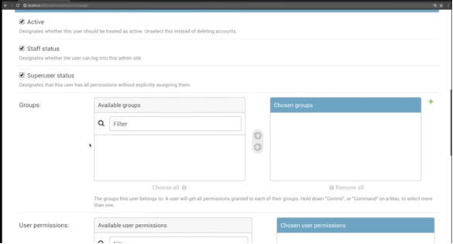
Status Check Page

Slide 27
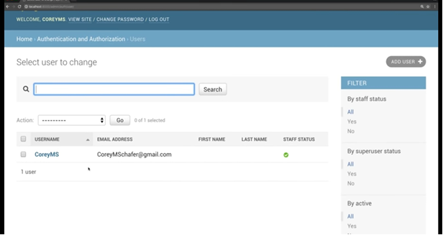
No. of Users page

Slide 28
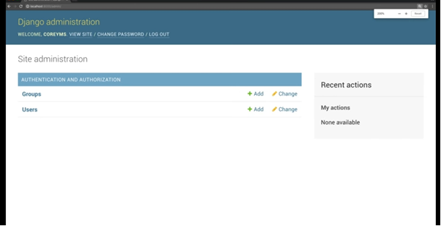
Groups and user page

Slide 29

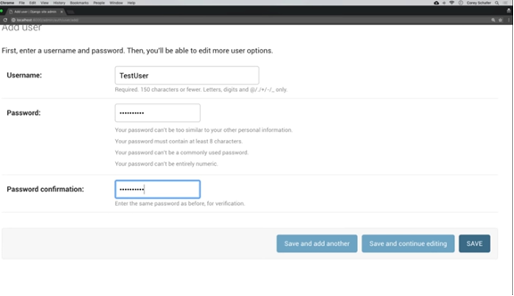
Add User Page

Slide 30

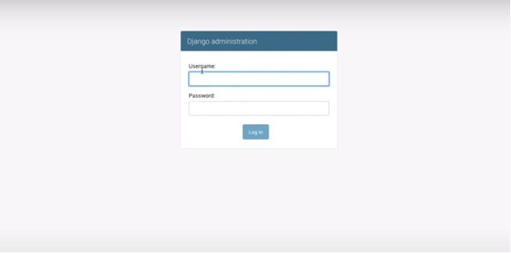
Admin login page

Slide 31

Through this project, we have successfully implemented a complete Bonpod website using HTML, CSS and JavaScript for the front end and Django framework for the backend and admin part and have estimated its techniques. Hence, these can be implemented to successfully log in the website and book a desired pod at any time. Also, we are getting the desired and accurate result while booking the pod and it is successfully implemented.

Slide 32


